Slide 1
Review Augmented and Geo-Based
Multi-User Restaurant Recommendation System
Hongyi Wang, Zhangming Sun, Jiawei Gu,
Shiau Kang Wang, Shichuan Wang, Tzu Ching Tsai
CS 6350 Big Data Management and Analytics
Professor: Prof. Latifur Khan

Slide 2
Motivation & Background
Most popular App only focus on individuals
Not working for a group of people
  Different opinion of each group member
Rating mechanism is too general & amount of restaurants are too large
  Hard to choose a suitable one

Slide 3
Tool & Language
Yelp Challenge Dataset
Programming language:
  Scala, Python
Tools:
  Spark, nltk library, Google Maps API

Slide 4
Overview
Distance Based Filter
ALS Method
Rating of Review Based on Vader
Visualization

Slide 5
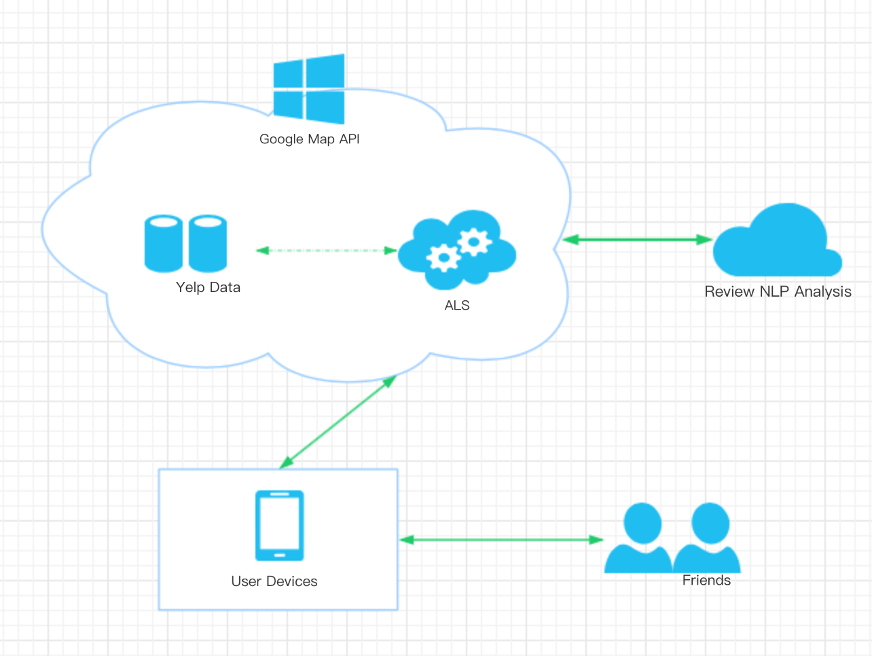
Overview(cont.)

Slide 6
Data preprocessing
  Las Vegas: Restaurants 4928
  2182: review_count > 50
  3131: review_count > 20
  3842: review_count > 10
  Cutomer: 686556
  236940: review_count>10
  148994: review_count>20
  70995: review_count>50
  23182: review_count>10, review at Las Vegas

Slide 7
Distance Based Filter
Google Maps Distance Matrix API
  Return information between start and end points
  Create matrix representing mutual distance between two points
  Display the relative position in user interface

Slide 8
Distance Based Filter(cont.)
Pro:
  Matrix makes system work more efficiently
Con:
  Google restrict the size of the matrix
solution:
  Divide the whole matrix into small pieces
  Set a boundary for restaurants

Slide 9
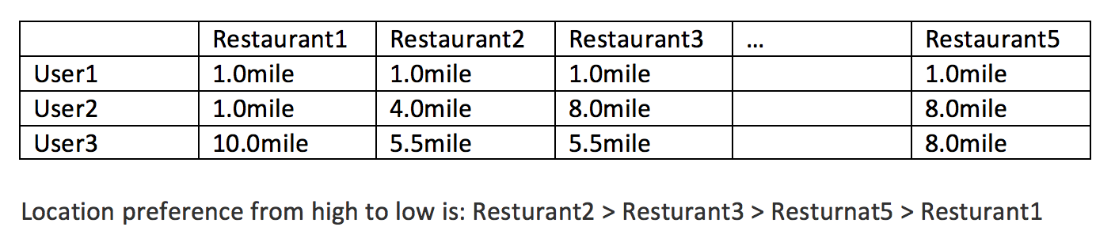
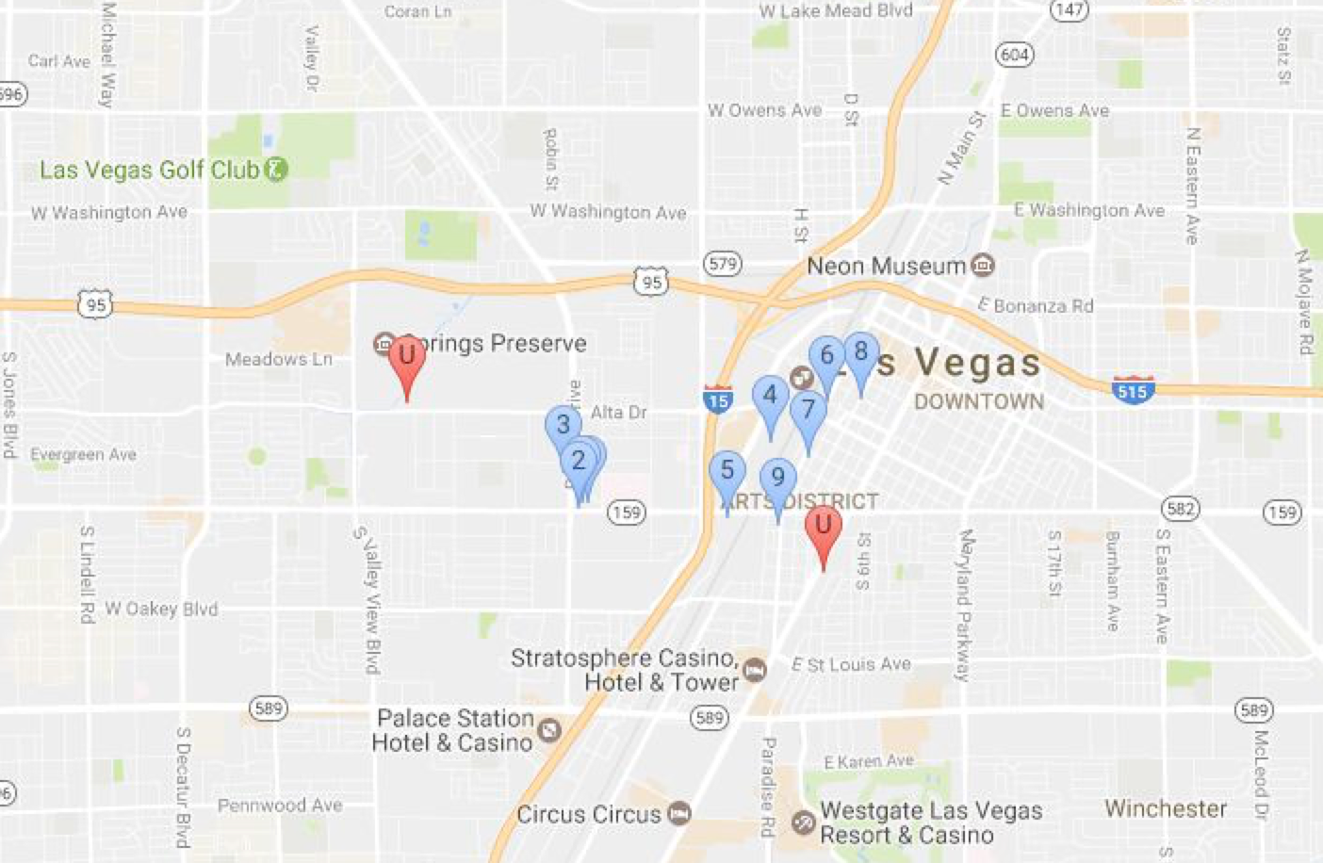

Slide 10
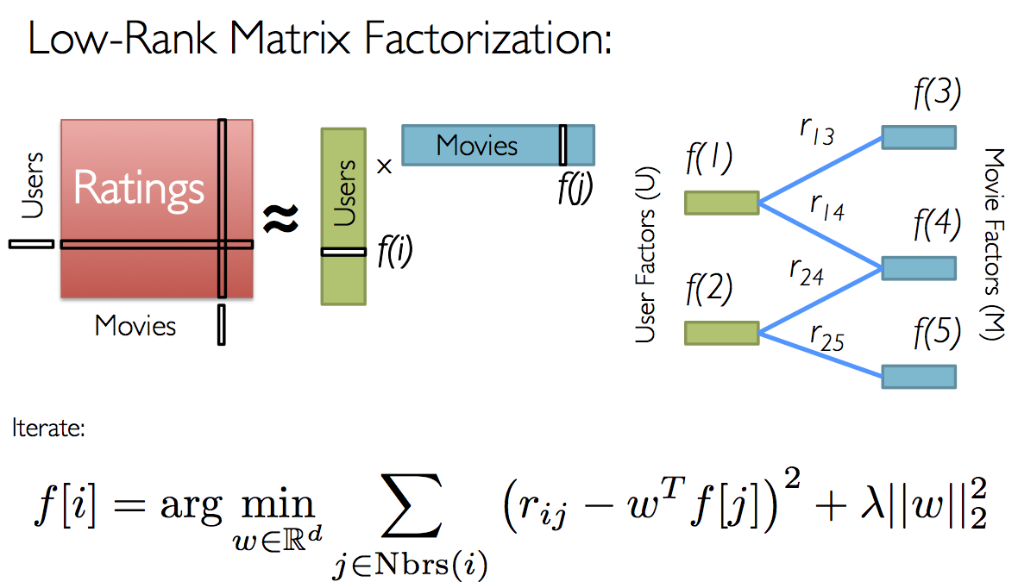
ALS Method

Slide 11
ALS Method
Advantages:
Collaborative filter is domain free, and provide generally better prediction.
ALS convert the nonconvex problem into two quadric problems.
ALS can be easily parallelized on distributed computing system.
Disadvantages:
1. Cold start problem.

Slide 12
ALS training
Only consider the last review of one (user, restaurant) pair.
Split whole data set into training(60%), test(20%), validation(20%).
The rank parameter was tuned from [80,90,100,110,120]
Final model gave a RMSE 1.113 on validation set with rank=120.
Original ratings were reserved after prediction of whole matrix.
6. Nans were replaced by restaurant average rating.

Slide 13
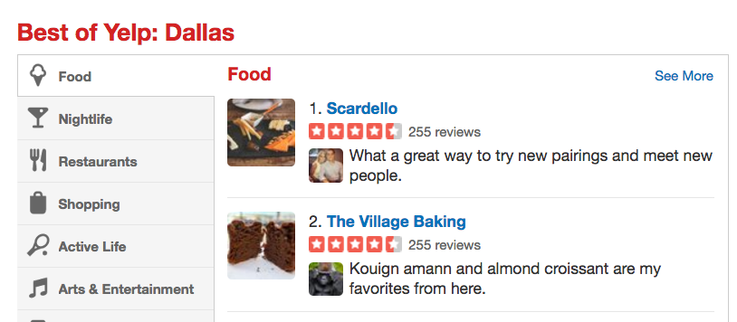
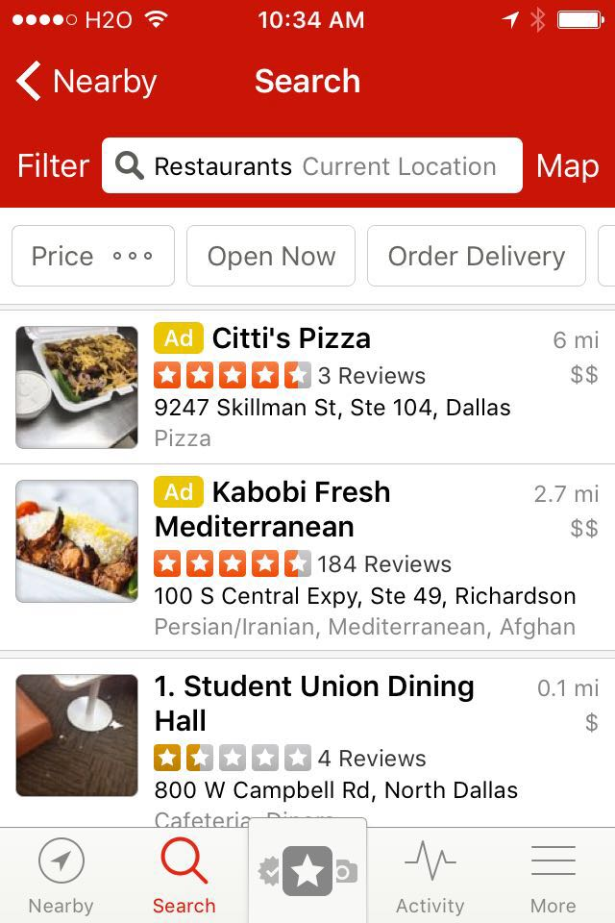
Why Sentiment Analysis?
The propose of sentimental analysis of user’s reviews is to provide a new recommend reference for users to choose the restaurant by their preference.
More detail in Restaurant??

Slide 14
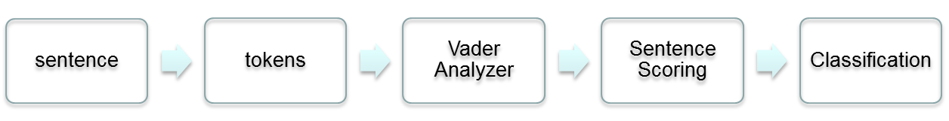
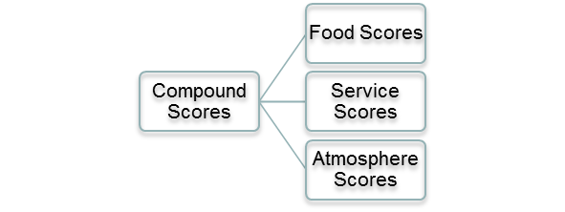
Vader Sentiment Analysis
Vader is a lexicon and rule-based sentiment analysis tool that is specifically attuned to sentiments expressed in social media, and works well on texts from other domains.
The easiest way is to use Naïve Bayes, and provide a suitable positive and negative training dataset for feature extraction.
When, however, people doesn’t have sufficient dataset, lexicon based sentiment analysis will be the best way to classify a bunch of un-label sentences.
Classification:

Slide 15
Rating of Review Based on Vader

Slide 16
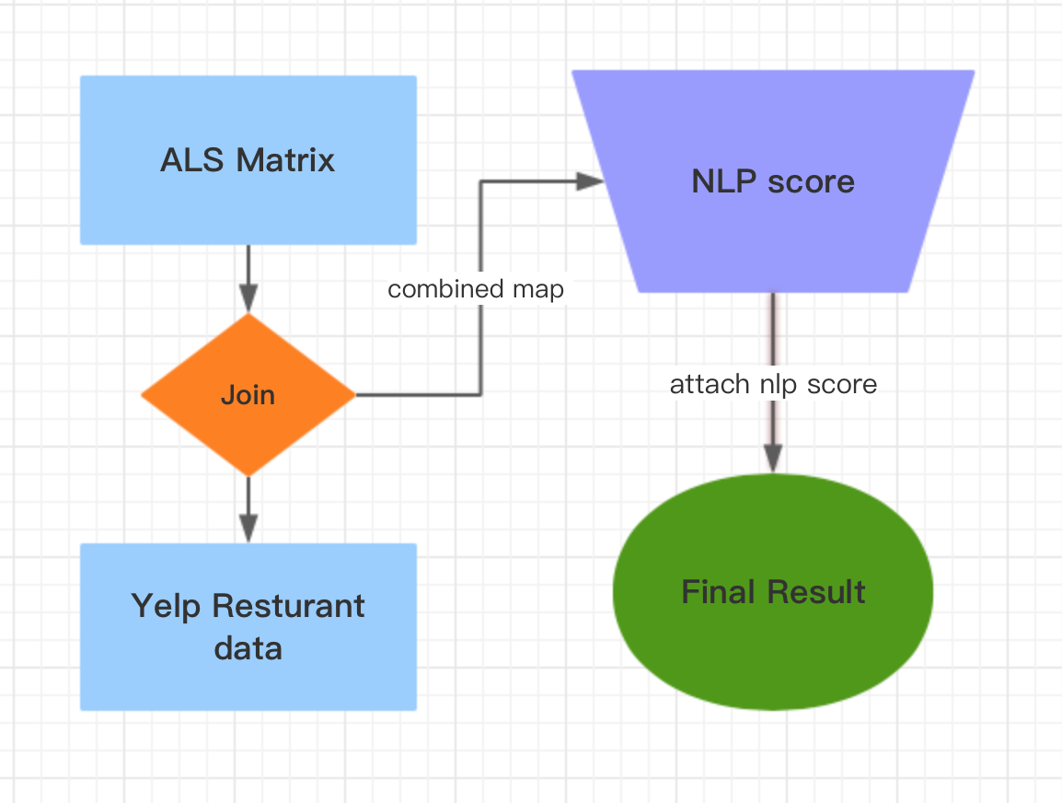
Visualization of result
GooMPy
(https://github.com/simondlevy/GooMPy ).

Slide 17
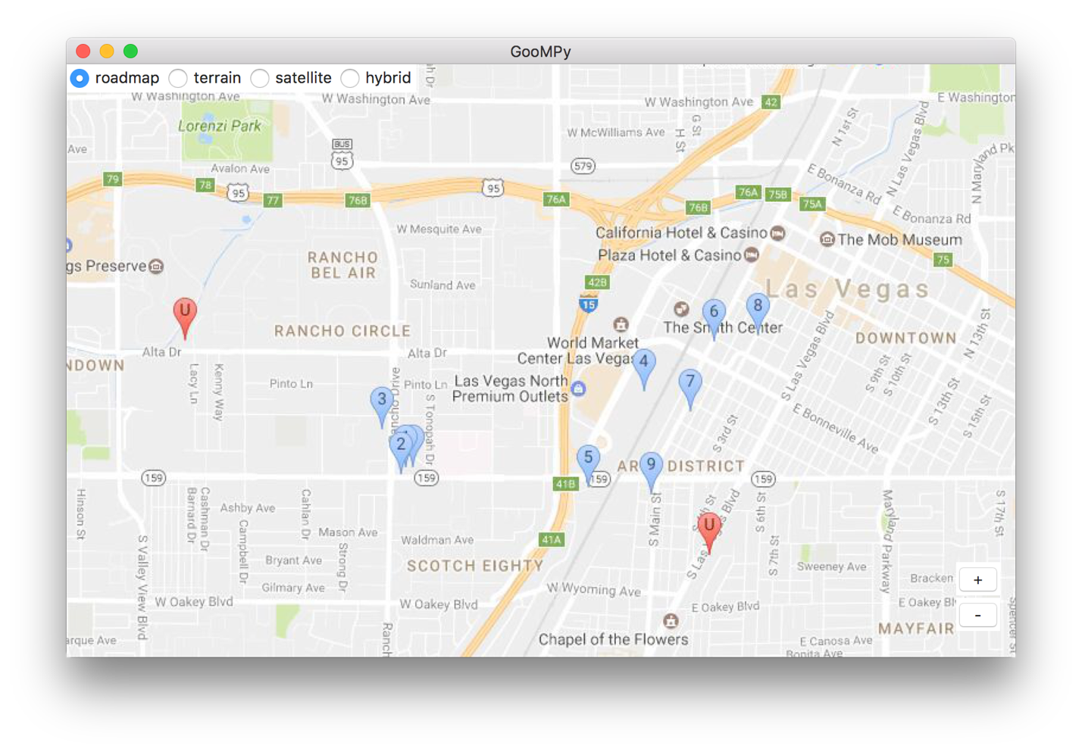


Slide 18

Demo

Slide 19

Thank you!!!

